Slide 1
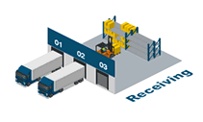
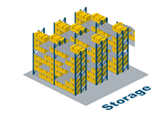
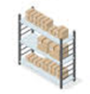
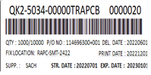
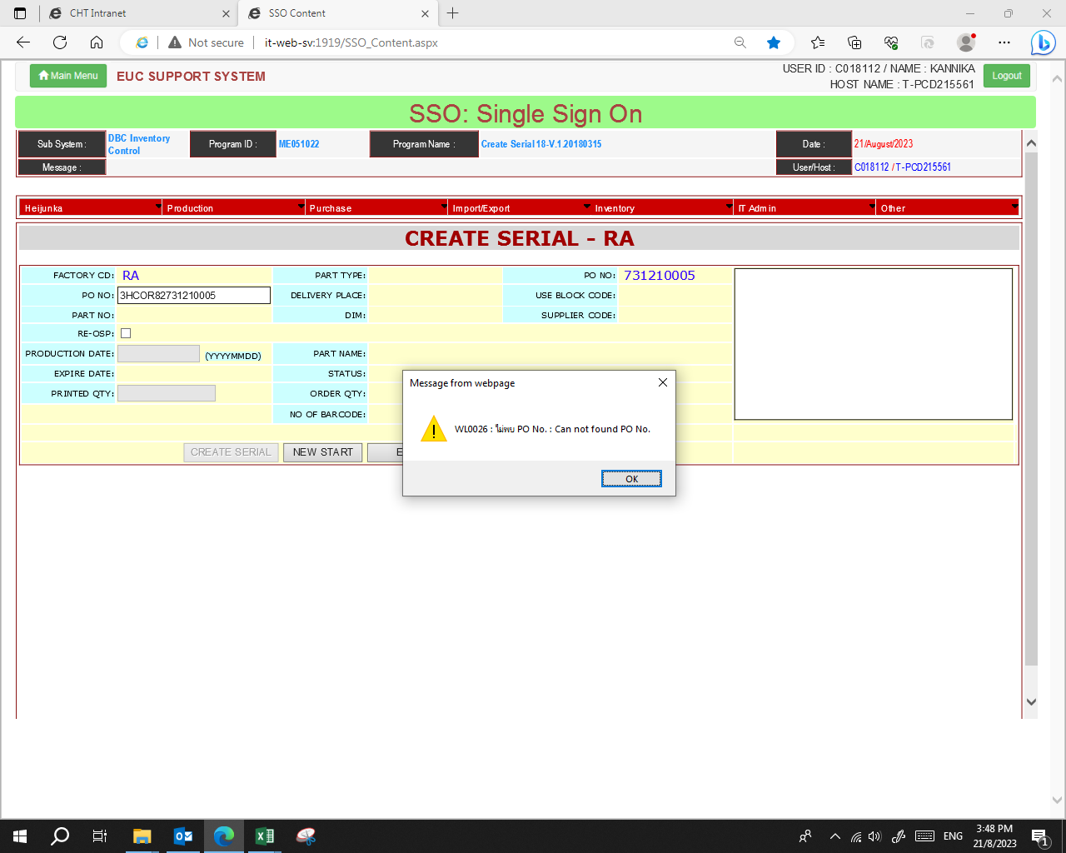
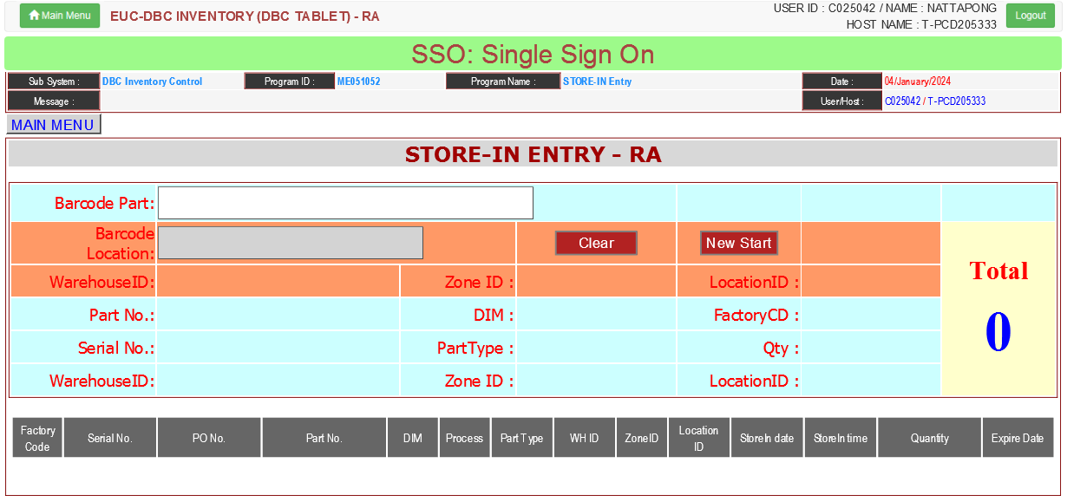




DBC-RA2
PLD
Operation flow
Receiving & Inspection
Free location
Store fixed
Move & Keep Part
Store-In
Warning Part
SSO
PCB
Warning Part
1.Serial No.
2.PO No
3.DC Code
Modify PCB System
Repackage
Store
[1] Man Check DC code & Create label
[2] System Sorting Serial refer. Expire date

Slide 2
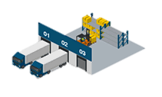
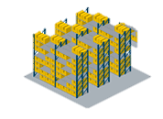
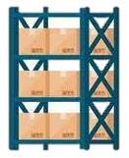


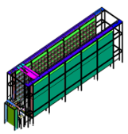
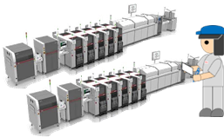


DBC-RA2
PLD
Operation flow
Current Operation at Child Part PCB
[1] Part Delivery
[2] Man Move to Free location
[3] Man Store-In to Fix location
[4] Man Pick part from Paper
Manual Kanban
PO Deleted
Serial Expire
Receive
PCB
Warning Part
Smart Store
Man MFG
Man Store
Man Store
Man Store
Auto Kanban
Obstruction for improvement
Condition of PO on system delete every 4 Month
Condition for request to ICS modify for deleted Data
PO status print all complete & Store-In all Complete
PO status close
Repack
[5] System Pick part from system request
List Part Repack
[1] Zone T
[2] Smart Store
[3] Strategic Part
Target Operation at Child Part PCB
Manual Kanban
PO Deleted
Serial Expire
Receive
PCB
Warning Part
Smart Store
Man MFG
Man Store
Man Store
Man Store
Auto Kanban
Repack

